Slide 1

 | BMS INSTITUTE OF TECHNOLOGY & MANAGEMENT, YELAHANKA, BANGALORE. Department of Artificial Intelligence and Machine Learning
IoT and ML-Driven Water Forensics for Illegal Dumping Detection
1. SIRI MANJUNATH [1BY22AI098]
2. SMRITI [1BY22AI099]
3. SONALI KUMARI [1BY22AI100]
4. TISHA SAKLECHA [1BY22AI110]
Under the guidance of:
Dr. Manoj H M
Associate Professor
Dept. of AIML
BMSIT&M
2024-25

Slide 2
Abstract of Project: Brief description of Project.
Methodology: Theoretical Analysis / Experimental Observations / Novel Algorithms / Tools / Techniques.
Implementation : Proposed Methodology for each objective and the implementation of each module of the project – diagram and description.
System testing : All Possible Test cases – The implemented project should be tested against all possible inputs and should be checked for the expected outcomes.
Results and Discussions: Output of the implemented project- Screen shots and description.
Conclusion : Self introspection of the project.
References: (IEEE format) – what you referred?

Slide 3
ABSTRACT
Illegal dumping harms water bodies and ecosystems. This project uses IoT sensors for real-time monitoring, machine learning for anomaly detection, and GIS for mapping pollution sources. The system ensures rapid response and long-term environmental protection.

Slide 4
Methodology
Data Collection: IoT sensors monitor water bodies, collecting real-time data on parameters like pH, turbidity, dissolved oxygen, and chemical concentrations.
Machine Learning: Anomaly detection models (e.g., Isolation Forest, One-Class SVM) are trained on baseline clean water data to identify abnormal sensor readings indicating contamination.
Alert Mechanism: A cloud-based system (e.g., Firebase/Google Cloud) triggers alerts via SMS, email, or app notifications when contamination thresholds are exceeded, enabling rapid response.
GIS Integration: QGIS or ArcGIS visualizes contamination data, highlighting high-risk zones for efficient resource allocation and trend analysis.
Testing and Validation: Extensive testing with real and simulated data ensures the system's accuracy, reliability, and timely alerting, with ongoing model and threshold refinements.

Slide 5
IMPLEMENTATION
Data Collection
GIS Mapping for Contamination Tracking
Real-Time Alerts
Anomaly Detection Using ML
Predictive Analysis for Future Trends
System Testing and Calibration
IoT Sensor Deployment
Data Preprocessing
Fig 1: Workflow model for water quality monitoring and analysis

Slide 6
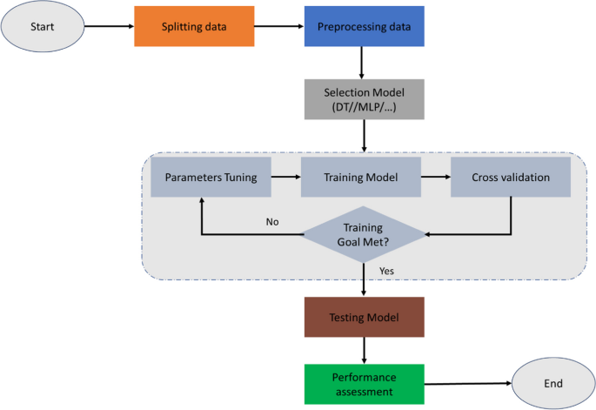
Fig 2: Flowchart of machine learning modeling

Slide 7
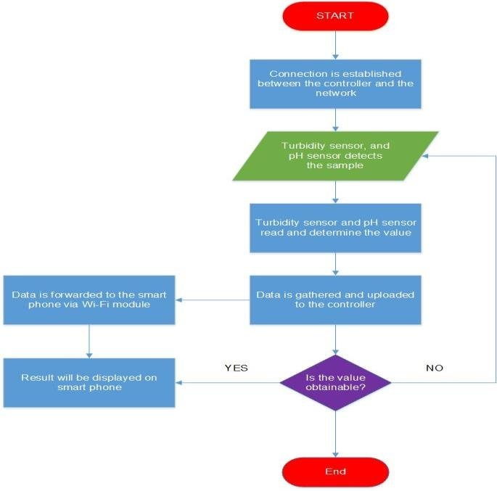
Fig 3: Flowchart of IoT water monitoring system

Slide 8
SYSTEM TESTING
Data Collection:
Sensor Integration Test
Input: Connect all sensors (pH, turbidity, DO, chemical sensors) to the ESP32 microcontroller.
Expected Outcome: Each sensor transmits accurate and stable data to the ESP32 without errors.
Sensor Data Accuracy
Input: Simulate various water conditions (e.g., polluted vs. clean water).
Expected Outcome: Sensors report the correct readings as per the actual water parameters.
Real-time Data Transmission
Input: Transmit live sensor data to the cloud server.
Expected Outcome: Data should be transmitted without delays and visible in real-time.
Machine Learning (ML) Anomaly Detection:
1. Training and Validation
Input: Provide baseline clean water data for training.
Expected Outcome: The ML model learns and establishes accurate thresholds for anomaly detection.
2. Anomaly Detection Accuracy
Input: Simulate contamination by altering pH, turbidity, or chemical levels.
Expected Outcome: The ML model flags anomalies with minimal false positives or negatives.

Slide 9
REFERENCES
[1]. N. K. Koditala and P. S. Pandey, "Water Quality Monitoring System Using IoT and Machine Learning," IEEE IoT and Machine Learning Journal, 2018.
[2]. U. Shafi, R. Mumtaz, H. Anwar, A. M. Qamar, and H. Khurshid, "Surface Water Pollution Detection using Internet of Things," IEEE Internet of Things Journal, 2018.
[3]. M. S. U. Chowdury, T. B. Emran, S. Ghosh, A. Pathak, M. M. Alam, N. Absar, K. Andersson, and M. S. Hossain, "IoT Based Real-time River Water Quality Monitoring System," Science Direct IoT Journal, 2019.
[4]. A. L. Lopez, N. A. Haripriya, K. Raveendran, S. Baby, and C. V. Priya, "Water quality prediction system using LSTM NN and IoT," 2021 IEEE International Power and Renewable Energy Conference (IPRECON), 2021
[5]. Zhu, J. Wang, X. Yang, Y. Zhang, L. Zhang, and H. Ren, "Machine learning used in water quality monitoring and prediction," ScienceDirect ML Journal, 2022.

Slide 10
[6]. Gour, N. K. Suniya, U. Kumar, K. Parihar, K. Kanwar, and S. K. Meena, "Water Quality Monitoring in Arid Regions of Western Rajasthan: Integrated IoT-GIS Framework," ResearchGate Journal, 2022.
[7]. M. Govindasamy, K. Jayanthi, and S. Rajagopan, "IoT Product on Smart Water Quality Monitoring System (IoT Wq-Kit) for Puducherry Union Territory," IEEE Internet of Things Journal, 2023.
[8]. U. G. Sharanya, K. M. Birabbi, B. H. Sahana, D. M. Kumar, N. Sharmila, and S. M. Swamy, "IoT-based Water Quality and Leakage Monitoring System for Urban Water Systems Using Machine Learning Algorithms," IEEE Internet of Things Journal, 2024.
[9]. Essamlali, H. Nhaila, and M. El Khaili, "Advances in Machine Learning and IoT for Water Quality Monitoring," NLM Journal, 2024.
[10]. G. M. el Amin, B. Soumia, and B. Mostefa, "Water Quality Drinking Classification Using Machine Learning," IEEE ML Journal, 2024.
[11]. U. Banerjee, V. P. V, K. Sharma, J. Thomas, P. Sawant, and V. K. Pandey, "Detecting Lake Water Quality Using Machine Learning and Image Processing," IEEE ML and Image Processing Journal, 2023.
[12]. O. O. Flores-Cortez, "A Low-Cost IoT System for Water Quality Monitoring in Developing Countries," IEEE 21st Consumer Communications & Networking Conference (CCNC), 2024

